Slide 1


Compound Words Guessing Game
Many of the German Compound Words (made up of two words) are
Very descriptive and when directly translated can be quite funny for
English speakers. This is a guessing game for the class to see can
they figure out what the Compound word means.
https://resources-for-german.com

Slide 2

Krankenhaus
Sick
House
Krankenschwester
Krankenwagen

Slide 3
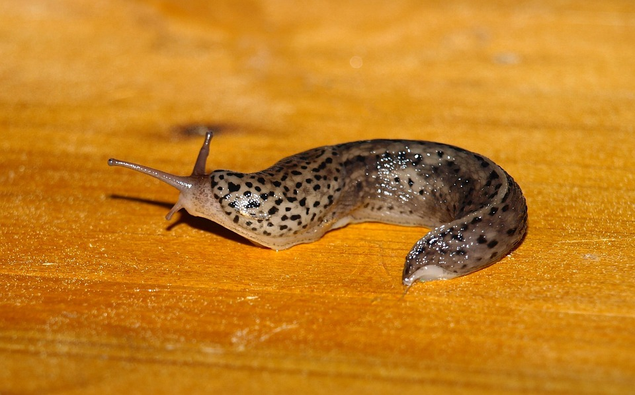
Nacktschnecke
Naked
Snail

Slide 4
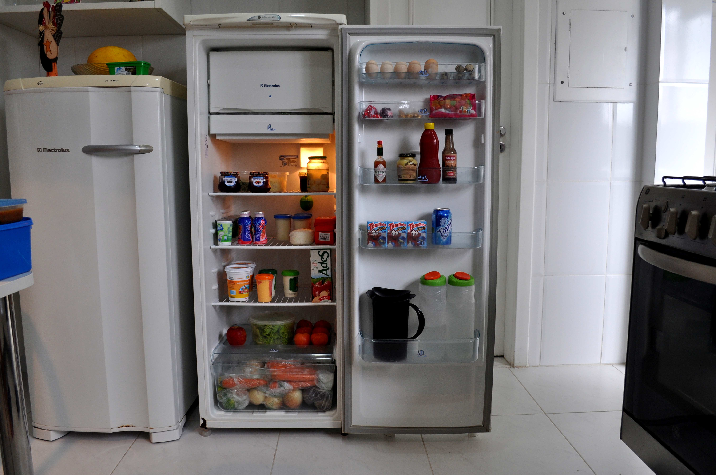
Kühlschrank
cool
wardrobe

Slide 5

Fehrnweh
distant
pain

Slide 6
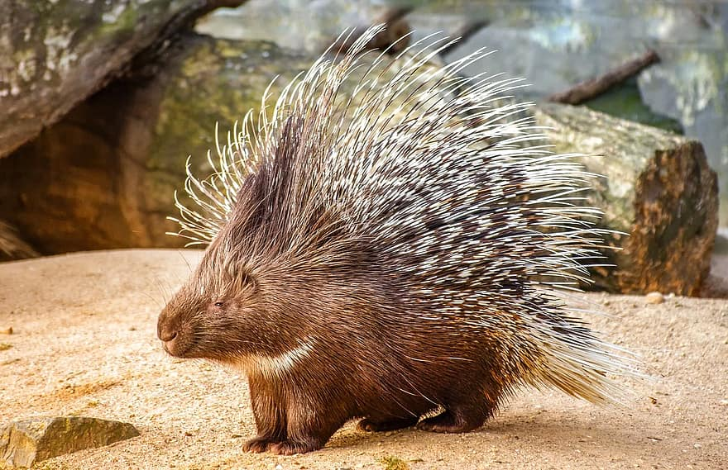
Stachelschwein
Spike
Pig

Slide 7
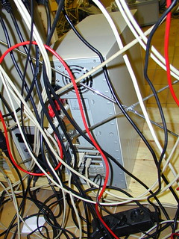
Kabelsalat
Cabel
Salad

Slide 8

Poltergeist
Noisy/rumbling
ghost

Slide 9

Schadenfreude
damage
Joy/delight

Slide 10

Glühbirne
glow
pear

Slide 11
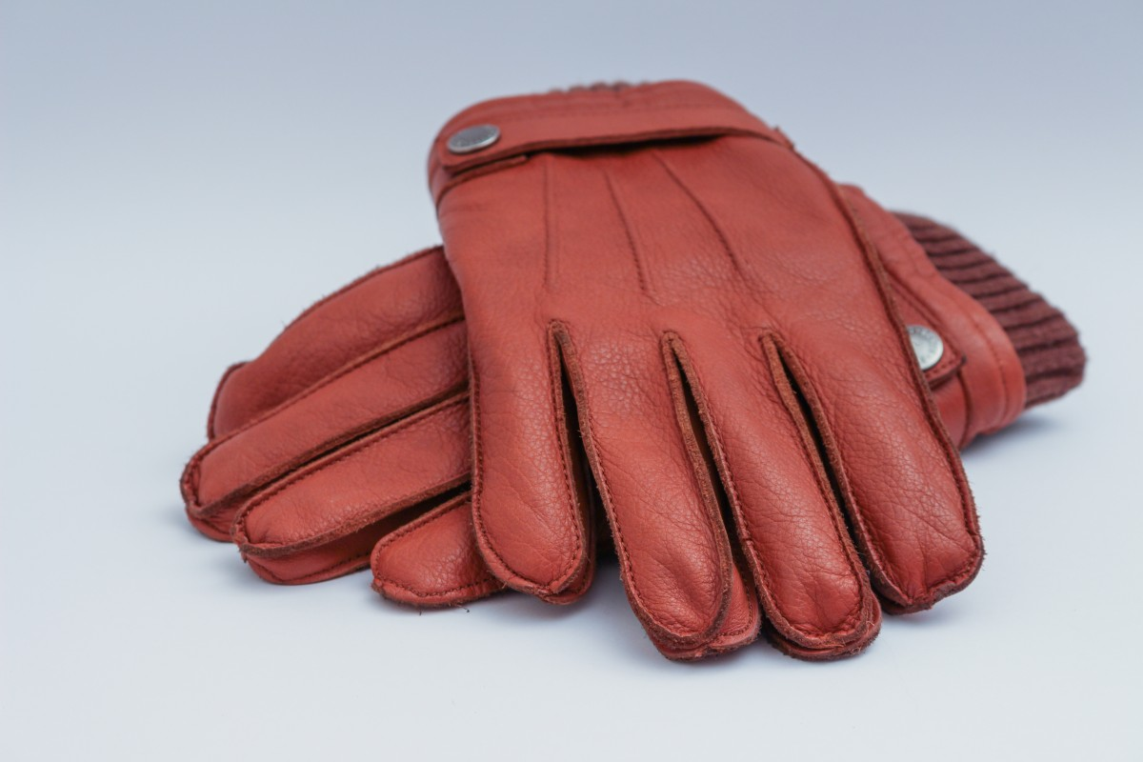
Handschuhe
hand
shoes

Slide 12
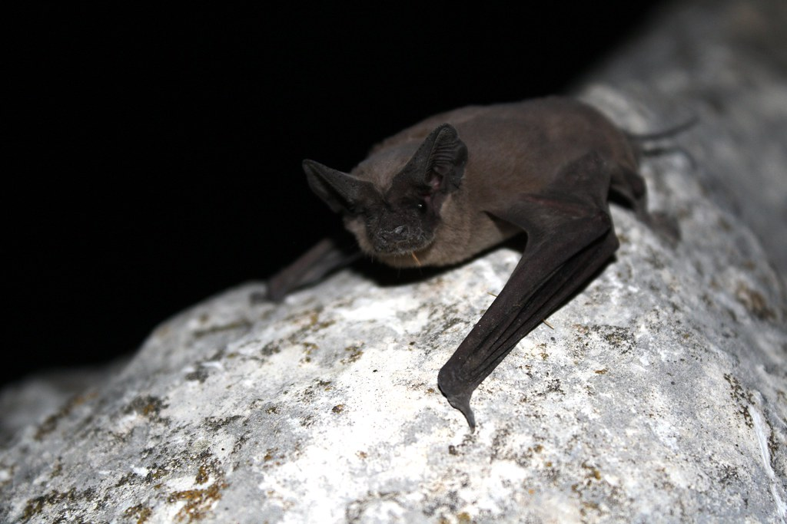
Fledermaus
Flutter
mouse

Slide 13

Staubsauger
dust
sucker

Slide 14

Warteschlange
waiting
snake

Slide 15

Flugzeug
fly
thing
Feuerzeug,
Spielzeug,
Fahrzeug

Slide 16
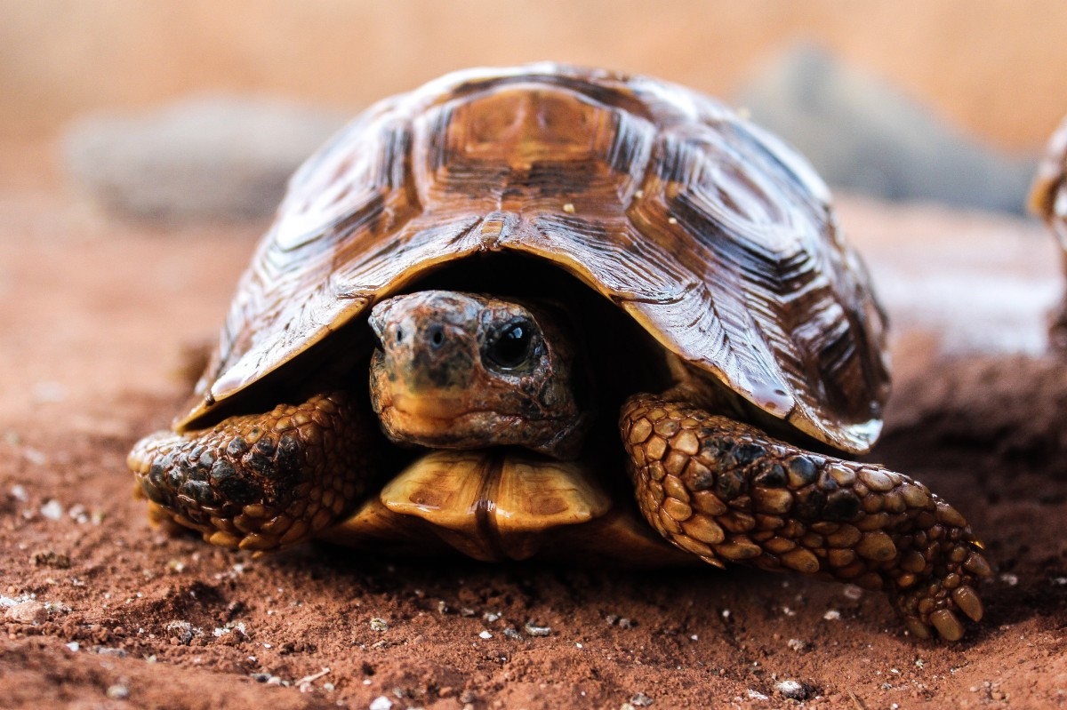
Schildkröte
shield
toad

Slide 17

Kummerspeck
sorrow
bacon

Slide 18
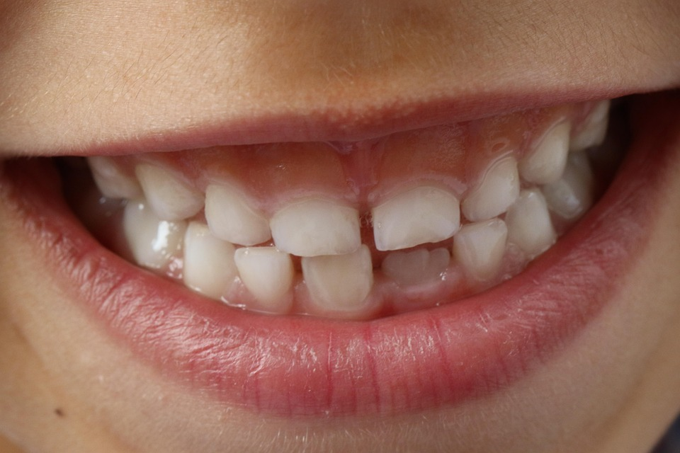
Zahnfleisch
tooth
meat

Slide 19
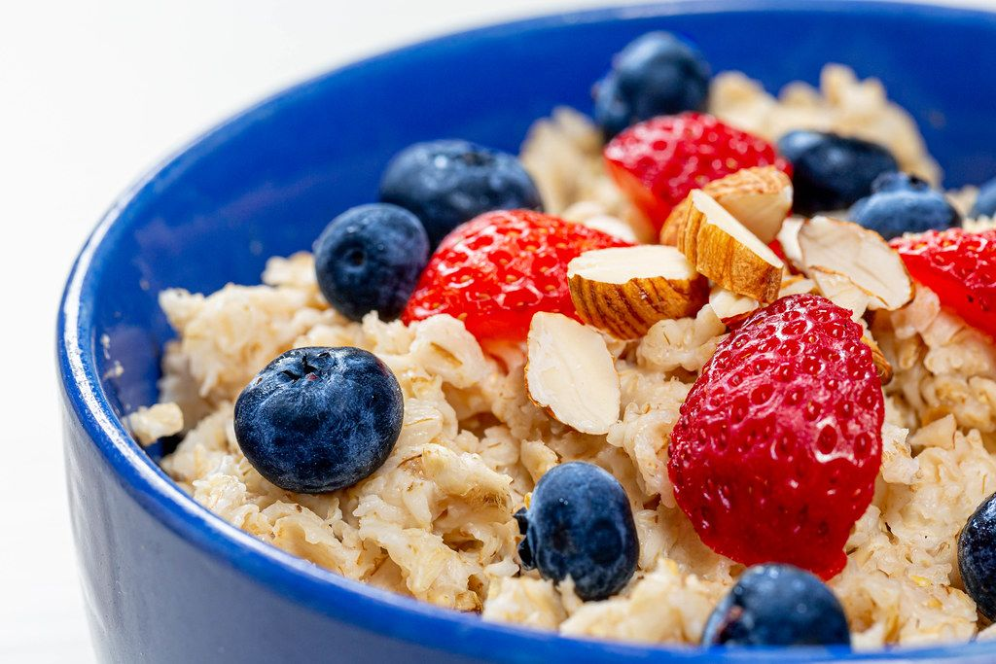
Haferschleim
oat
slime

Slide 20
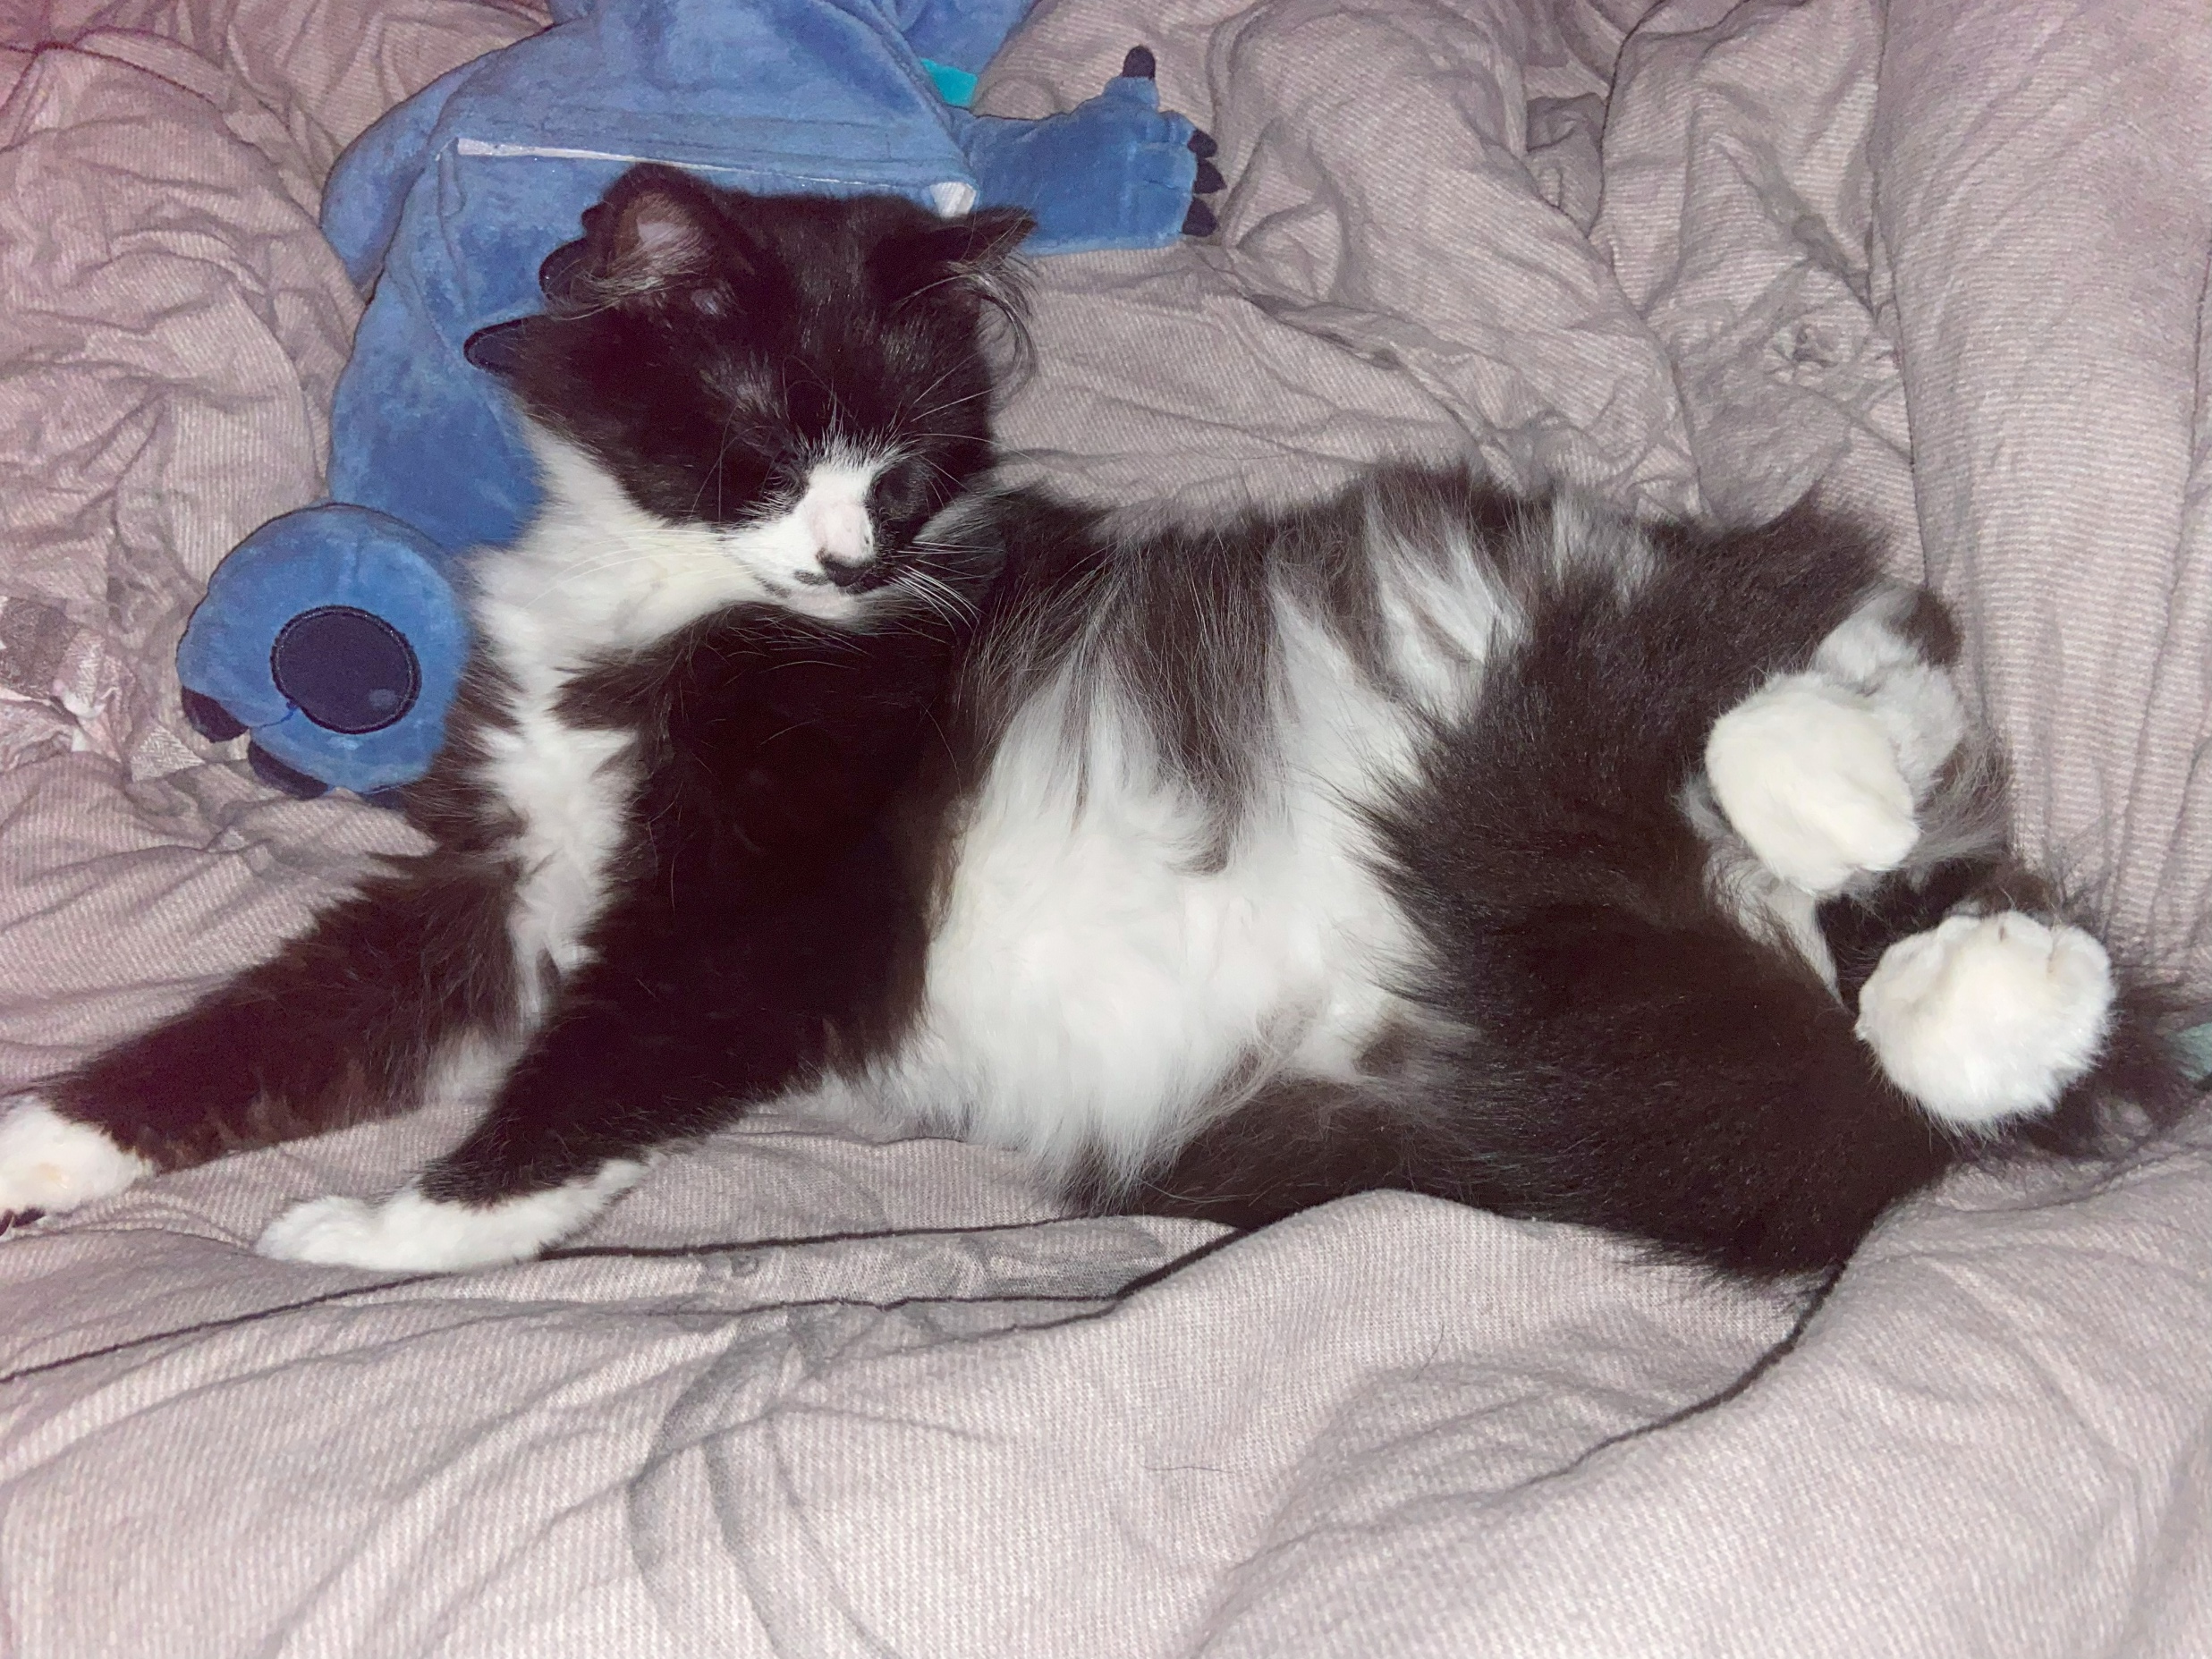
Stubentiger
house/living room
tiger

Slide 21

Schnapsidee
Schnaps
idea

